Slide 1



| University of San Jose - Recoletos | School of Computer Studies
| Quantitative Methods | Engr. Violdan E. Bayocot
LESSON 02.01 – TWO-WAY TABLE
MODULE 02
VISUALIZING DATA (PART 2)
ENGR. VIOLDAN E. BAYOCOT
[Krista K.] BECOME A PROBABILITY & STATISTICS MASTER
QUANTITATIVE METHODS

Slide 2
ONE-WAY VS TWO-WAY TABLES
One-way tables use data from one variable
Two-way tables organize data using two categorical variables
One-way tables have:
1 independent variable (individuals)
Dependent variables (measured values)
Two-way tables have:
2 independent categories affecting the data
The difference is best understood by comparing their data tables
ENGR. VIOLDAN E. BAYOCOT
[Krista K.] BECOME A PROBABILITY & STATISTICS MASTER
QUANTITATIVE METHODS

Slide 3
ONE-WAY VS TWO-WAY TABLES
Month | Revenue
JAN | ₱482,000
FEB | ₱421,500
MAR | ₱513,000
APR | ₱544,000
MAY | ₱602,500
JUN | ₱678,000
JUL | ₱721,000
AUG | ₱704,500
SEP | ₱596,000
OCT | ₱634,000
NOV | ₱815,500
DEC | ₱942,000
Suppose a small coffee shop opened in early 2019 in the Philippines.
By the end of 2022, it had been operating for four years, and its revenue steadily increased each year.
If we total the revenue earned for each month across all four years, we can summarize the data in a one-way table.
ENGR. VIOLDAN E. BAYOCOT
[Krista K.] BECOME A PROBABILITY & STATISTICS MASTER
QUANTITATIVE METHODS

Slide 4
ONE-WAY VS TWO-WAY TABLES
Month | Revenue
JAN | ₱482,000
FEB | ₱421,500
MAR | ₱513,000
APR | ₱544,000
MAY | ₱602,500
JUN | ₱678,000
JUL | ₱721,000
AUG | ₱704,500
SEP | ₱596,000
OCT | ₱634,000
NOV | ₱815,500
DEC | ₱942,000
We have months on the left side;
those are the individuals (also called the independent variable).
The revenue is the variable (also called the dependent variable)
The revenue the coffee shop earned only depends on one thing: the month
We can ask questions like:
“How much revenue was earned in July?”
“Which month had the highest total revenue?”
ENGR. VIOLDAN E. BAYOCOT
[Krista K.] BECOME A PROBABILITY & STATISTICS MASTER
QUANTITATIVE METHODS

Slide 5
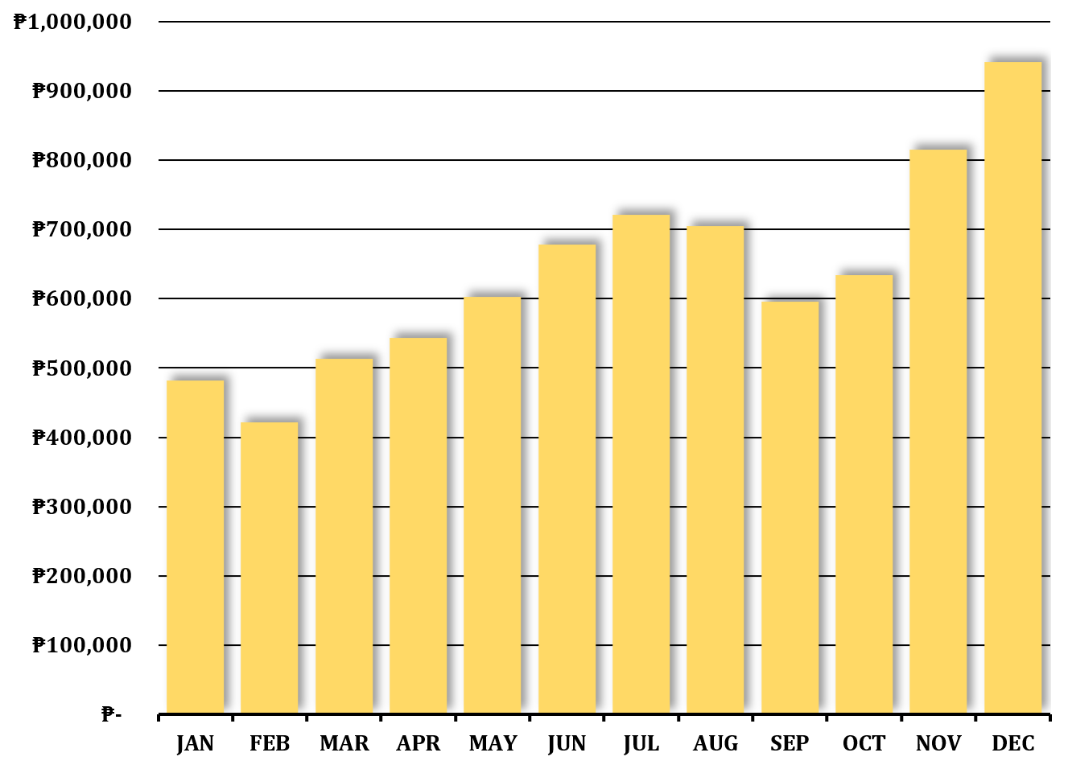
ONE-WAY VS TWO-WAY TABLES
Month | Revenue
JAN | ₱482,000
FEB | ₱421,500
MAR | ₱513,000
APR | ₱544,000
MAY | ₱602,500
JUN | ₱678,000
JUL | ₱721,000
AUG | ₱704,500
SEP | ₱596,000
OCT | ₱634,000
NOV | ₱815,500
DEC | ₱942,000
Let’s represent this as a bar graph
ENGR. VIOLDAN E. BAYOCOT
[Krista K.] BECOME A PROBABILITY & STATISTICS MASTER
QUANTITATIVE METHODS

Slide 6
ONE-WAY VS TWO-WAY TABLES
Month | Revenue
JAN | ₱482,000
FEB | ₱421,500
MAR | ₱513,000
APR | ₱544,000
MAY | ₱602,500
JUN | ₱678,000
JUL | ₱721,000
AUG | ₱704,500
SEP | ₱596,000
OCT | ₱634,000
NOV | ₱815,500
DEC | ₱942,000
Let’s represent this as a bar graph
This certainly gives us information about which months tend to be best for business
November and December seem to be best.
But since the data is summarized, adding the revenue for January for all four years into one figure, and for February, for March, for April, etc.,
This one-way data doesn’t give us any insight into how the business has grown over time.
ENGR. VIOLDAN E. BAYOCOT
[Krista K.] BECOME A PROBABILITY & STATISTICS MASTER
QUANTITATIVE METHODS

Slide 7
ONE-WAY VS TWO-WAY TABLES
Month | 2019 | 2020 | 2021 | 2022
JAN | ₱52,000 | ₱95,000 | ₱138,000 | ₱197,000
FEB | ₱48,000 | ₱82,000 | ₱121,000 | ₱170,500
MAR | ₱60,000 | ₱105,000 | ₱142,000 | ₱206,000
APR | ₱64,000 | ₱112,000 | ₱153,000 | ₱215,000
MAY | ₱72,000 | ₱125,000 | ₱168,000 | ₱237,500
JUN | ₱81,000 | ₱139,000 | ₱189,000 | ₱269,000
JUL | ₱89,000 | ₱151,000 | ₱201,000 | ₱280,000
AUG | ₱86,000 | ₱147,000 | ₱198,000 | ₱273,500
SEP | ₱71,000 | ₱123,000 | ₱162,000 | ₱240,000
OCT | ₱75,000 | ₱131,000 | ₱175,000 | ₱253,000
NOV | ₱98,000 | ₱188,000 | ₱240,000 | ₱289,500
DEC | ₱115,000 | ₱205,000 | ₱275,000 | ₱347,000
Month | Revenue
JAN | ₱482,000
FEB | ₱421,500
MAR | ₱513,000
APR | ₱544,000
MAY | ₱602,500
JUN | ₱678,000
JUL | ₱721,000
AUG | ₱704,500
SEP | ₱596,000
OCT | ₱634,000
NOV | ₱815,500
DEC | ₱942,000
In a two-way table, each value depends on two variables instead of one.
In a one-way table, revenue depends only on the month.
In a two-way table, revenue depends on both the year and the month.
We can graph the two-way table data in several ways.
ENGR. VIOLDAN E. BAYOCOT
[Krista K.] BECOME A PROBABILITY & STATISTICS MASTER
QUANTITATIVE METHODS

Slide 8
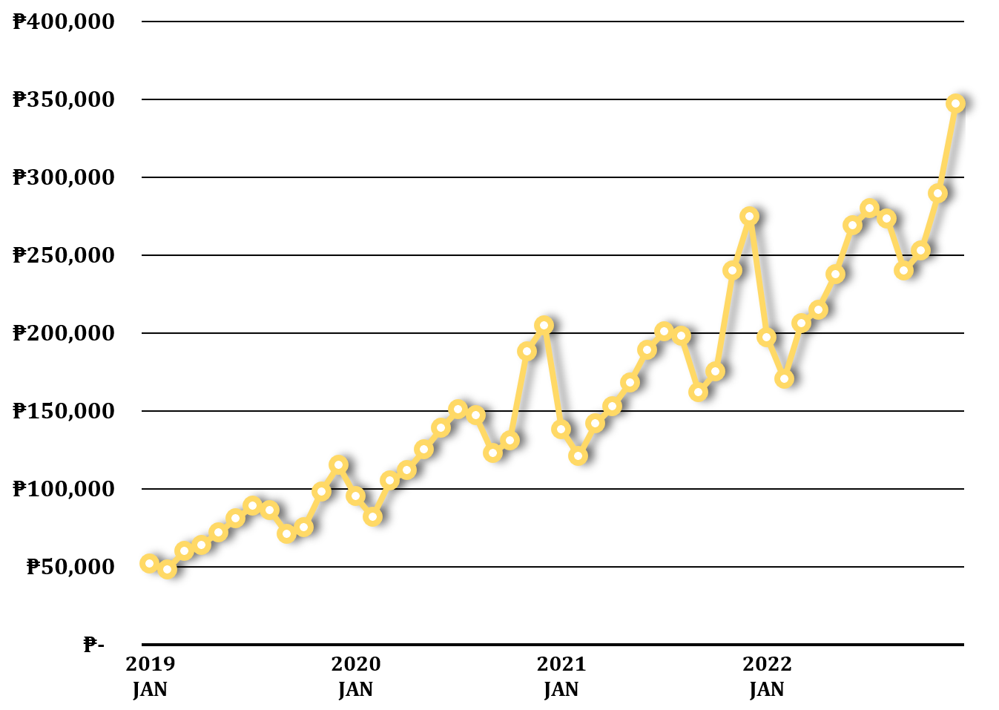
ONE-WAY VS TWO-WAY TABLES
shown as a line graph from January 2014 to December 2017.
Month | 2019 | 2020 | 2021 | 2022
JAN | ₱52,000 | ₱95,000 | ₱138,000 | ₱197,000
FEB | ₱48,000 | ₱82,000 | ₱121,000 | ₱170,500
MAR | ₱60,000 | ₱105,000 | ₱142,000 | ₱206,000
APR | ₱64,000 | ₱112,000 | ₱153,000 | ₱215,000
MAY | ₱72,000 | ₱125,000 | ₱168,000 | ₱237,500
JUN | ₱81,000 | ₱139,000 | ₱189,000 | ₱269,000
JUL | ₱89,000 | ₱151,000 | ₱201,000 | ₱280,000
AUG | ₱86,000 | ₱147,000 | ₱198,000 | ₱273,500
SEP | ₱71,000 | ₱123,000 | ₱162,000 | ₱240,000
OCT | ₱75,000 | ₱131,000 | ₱175,000 | ₱253,000
NOV | ₱98,000 | ₱188,000 | ₱240,000 | ₱289,500
DEC | ₱115,000 | ₱205,000 | ₱275,000 | ₱347,000
By giving the coffee shop’s revenue data in a two-way table, we get so much more insight into the business.
ENGR. VIOLDAN E. BAYOCOT
[Krista K.] BECOME A PROBABILITY & STATISTICS MASTER
QUANTITATIVE METHODS

Slide 9
SHOWING TOTALS
In a two-way table, data can be summarized by rows and columns, with a grand total in the lower right-hand corner.
Month | 2019 | 2020 | 2021 | 2022
JAN | ₱52,000 | ₱95,000 | ₱138,000 | ₱197,000
FEB | ₱48,000 | ₱82,000 | ₱121,000 | ₱170,500
MAR | ₱60,000 | ₱105,000 | ₱142,000 | ₱206,000
APR | ₱64,000 | ₱112,000 | ₱153,000 | ₱215,000
MAY | ₱72,000 | ₱125,000 | ₱168,000 | ₱237,500
JUN | ₱81,000 | ₱139,000 | ₱189,000 | ₱269,000
JUL | ₱89,000 | ₱151,000 | ₱201,000 | ₱280,000
AUG | ₱86,000 | ₱147,000 | ₱198,000 | ₱273,500
SEP | ₱71,000 | ₱123,000 | ₱162,000 | ₱240,000
OCT | ₱75,000 | ₱131,000 | ₱175,000 | ₱253,000
NOV | ₱98,000 | ₱188,000 | ₱240,000 | ₱289,500
DEC | ₱115,000 | ₱205,000 | ₱275,000 | ₱347,000
Total
₱482,000
₱421,500
₱513,000
₱544,000
₱602,500
₱678,000
₱721,000
₱704,500
₱596,000
₱634,000
₱815,500
₱942,000
From the two-way table, we can see the revenue totals for each month along the right side of the table.
We can also see the revenue totals for each year along the bottom of the table.
The best month for the business is December, and the best year is now 2022.
These totals match the values in the one-way table.
Total | ₱911,000 | ₱1,603,000 | ₱2,162,000 | ₱2,978,000 | ₱7,654,000
ENGR. VIOLDAN E. BAYOCOT
[Krista K.] BECOME A PROBABILITY & STATISTICS MASTER
QUANTITATIVE METHODS

Slide 10
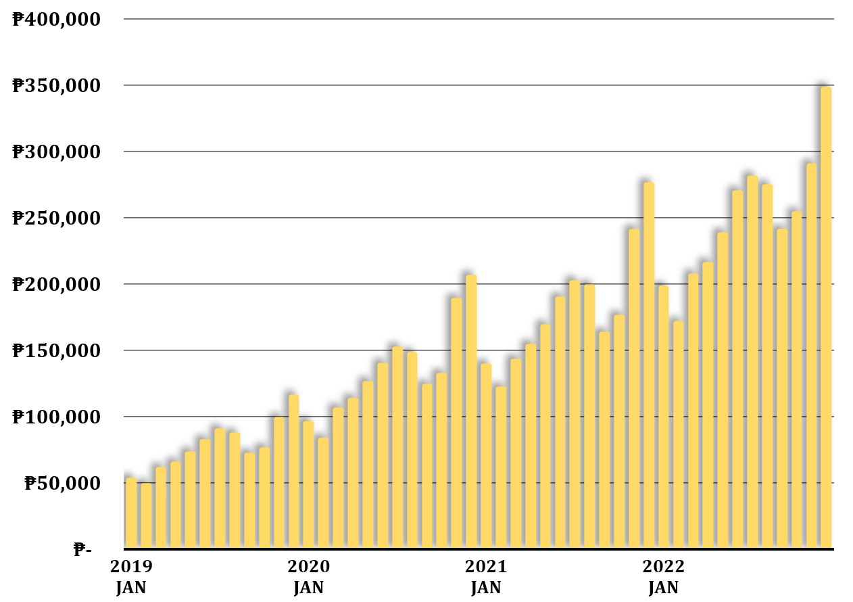
SHOWING TOTALS
We could also do a bar graph to represent all of this data over time
ENGR. VIOLDAN E. BAYOCOT
[Krista K.] BECOME A PROBABILITY & STATISTICS MASTER
QUANTITATIVE METHODS

Slide 11
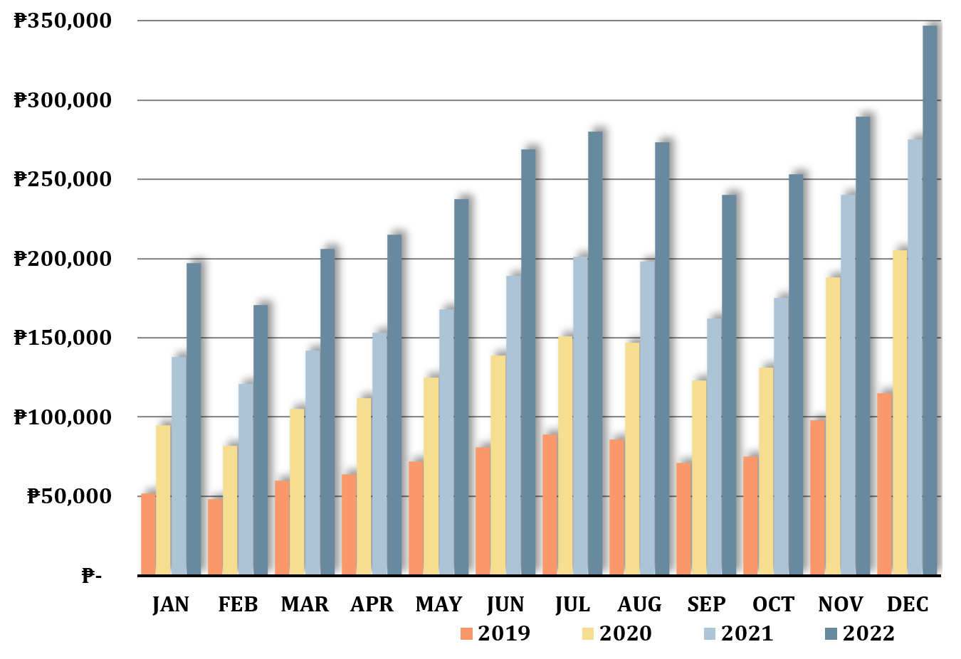
SHOWING TOTALS
We could also create a comparison bar graph, illustrating the revenue totals with side-by-side color coded bars for each year …
ENGR. VIOLDAN E. BAYOCOT
[Krista K.] BECOME A PROBABILITY & STATISTICS MASTER
QUANTITATIVE METHODS

Slide 12
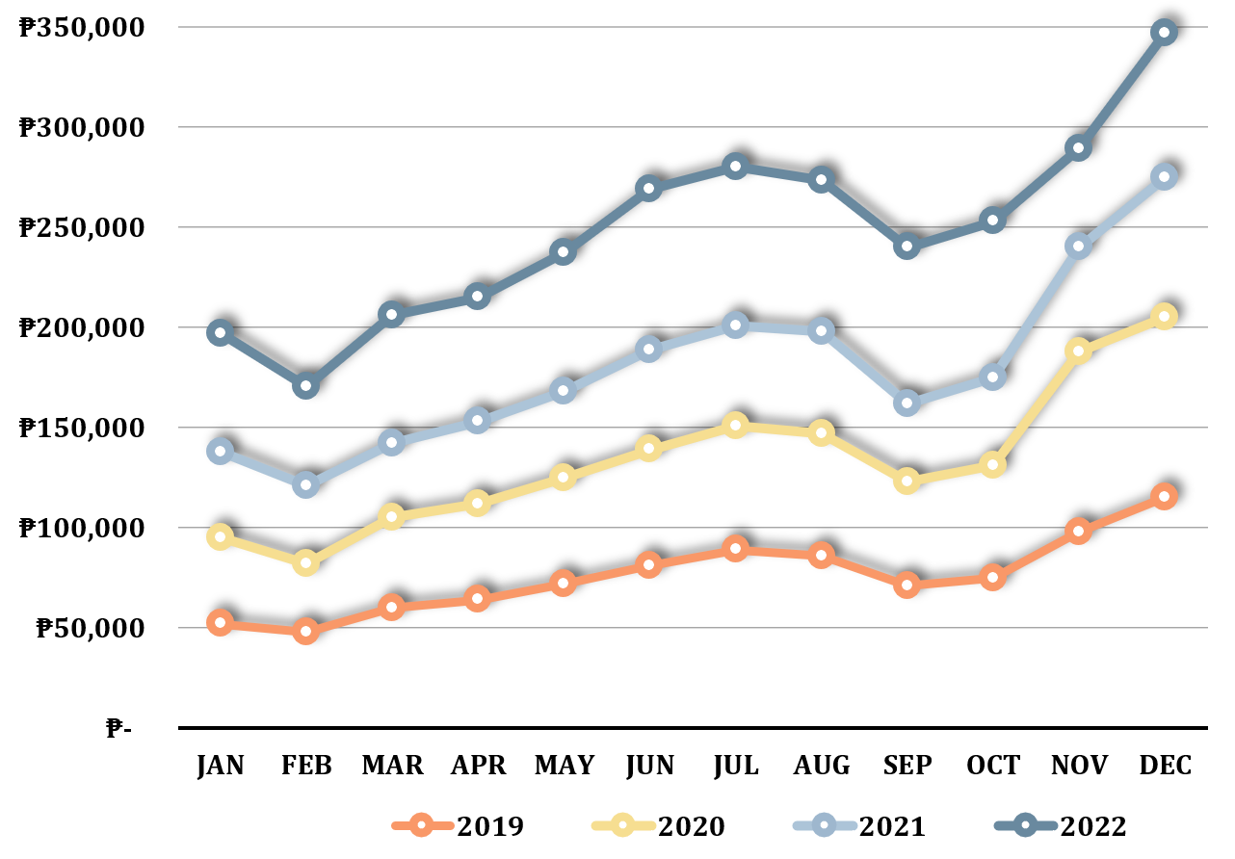
SHOWING TOTALS
… or a comparison line graph, depicting color-coded line graphs for each year.
ENGR. VIOLDAN E. BAYOCOT
[Krista K.] BECOME A PROBABILITY & STATISTICS MASTER
QUANTITATIVE METHODS

Slide 13
| University of San Jose - Recoletos | School of Computer Studies
| Quantitative Methods | Engr. Violdan E. Bayocot
LESSON 02.02 – VENN DIAGRAM
MODULE 02
VISUALIZING DATA (PART 2)
ENGR. VIOLDAN E. BAYOCOT
[Krista K.] BECOME A PROBABILITY & STATISTICS MASTER
QUANTITATIVE METHODS

Slide 14



VENN DIAGRAM
A Venn diagram visually shows how groups overlap.
It’s another way to represent data from a two-way table.
Popcorn
Soda
ENGR. VIOLDAN E. BAYOCOT
[Krista K.] BECOME A PROBABILITY & STATISTICS MASTER
QUANTITATIVE METHODS

Slide 15
VENN DIAGRAM
A Venn diagram visually shows how groups overlap.
It’s another way to represent data from a two-way table.
 | Soda | No Soda | Total
Popcorn | 5 | 6 | 11
No Popcorn | 4 | 5 | 9
Total | 9 | 11 | 20
Popcorn
Soda
ENGR. VIOLDAN E. BAYOCOT
[Krista K.] BECOME A PROBABILITY & STATISTICS MASTER
QUANTITATIVE METHODS

Slide 16
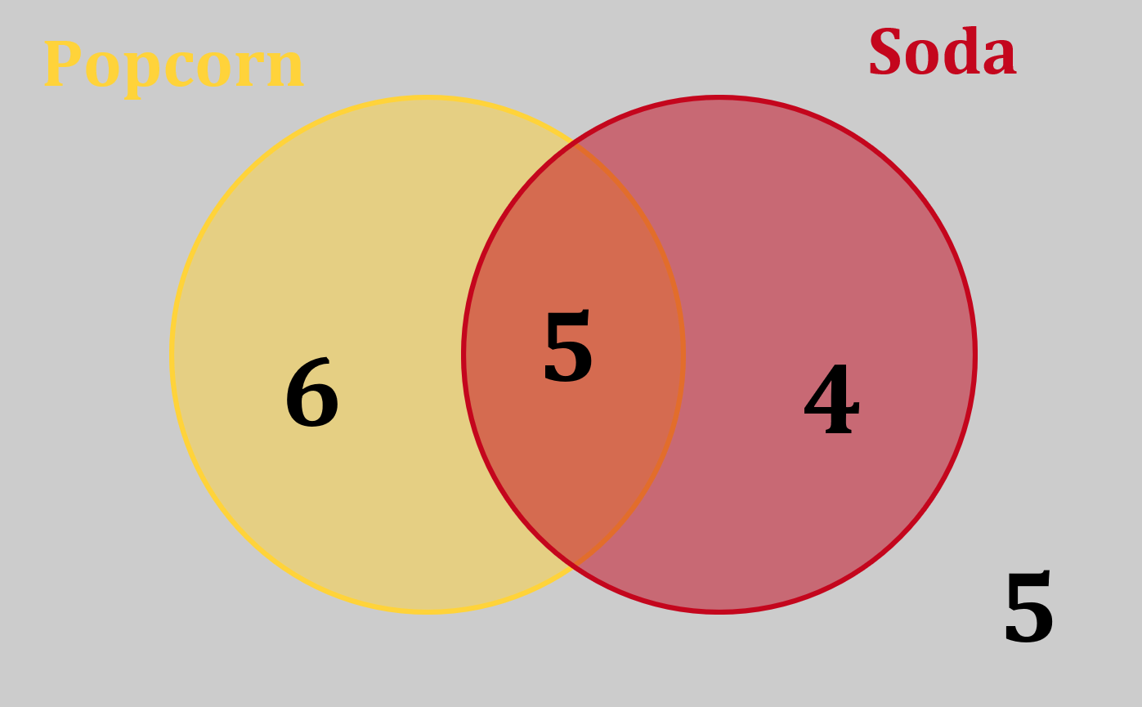
VENN DIAGRAM
 | Soda | No Soda | Total
Popcorn | 5 | 6 | 11
No Popcorn | 4 | 5 | 9
Total | 9 | 11 | 20
ENGR. VIOLDAN E. BAYOCOT
[Krista K.] BECOME A PROBABILITY & STATISTICS MASTER
QUANTITATIVE METHODS

Slide 17
THREE-CIRCLE VENN DIAGRAM
Favorite Game Genre (Action, Strategy, Racing)
4 students like Action only
3 students like Strategy only
2 students like Racing only
5 students like Action and Strategy only
3 students like Action and Racing only
4 students like Strategy and Racing only
6 students like all three
3 students like none
ENGR. VIOLDAN E. BAYOCOT
[Krista K.] BECOME A PROBABILITY & STATISTICS MASTER
QUANTITATIVE METHODS

Slide 18
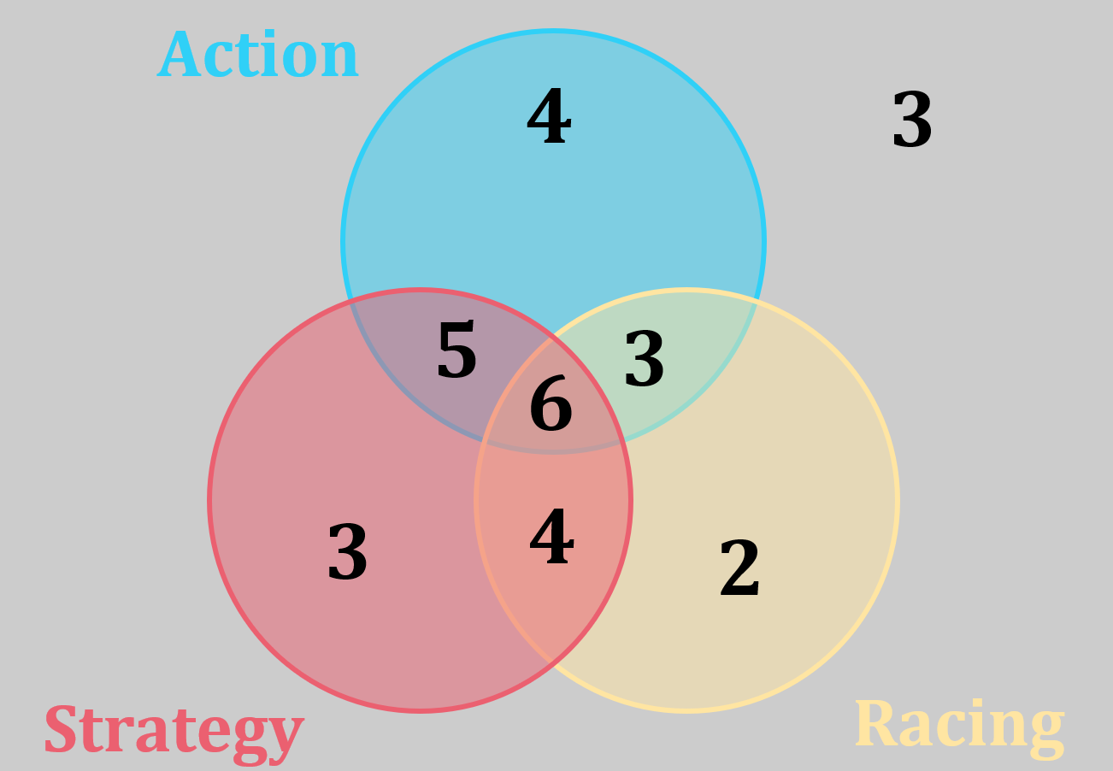
THREE-CIRCLE VENN DIAGRAM
Favorite Game Genre (Action, Strategy, Racing)
4 students like Action only
3 students like Strategy only
2 students like Racing only
5 students like Action and Strategy only
3 students like Action and Racing only
4 students like Strategy and Racing only
6 students like all three
3 students like none
ENGR. VIOLDAN E. BAYOCOT
[Krista K.] BECOME A PROBABILITY & STATISTICS MASTER
QUANTITATIVE METHODS

Slide 19
| University of San Jose - Recoletos | School of Computer Studies
| Quantitative Methods | Engr. Violdan E. Bayocot
LESSON 02.03 – FREQUENCY TABLES AND DOT PLOTS
MODULE 02
VISUALIZING DATA (PART 2)
ENGR. VIOLDAN E. BAYOCOT
[Krista K.] BECOME A PROBABILITY & STATISTICS MASTER
QUANTITATIVE METHODS

Slide 20
FREQUENCY TABLES AND DOT PLOTS
A frequency table shows how often or how rarely something occurs
A dot plot can also be used to display the frequency of small data sets
For example, pets in neighborhood by type can be categorized by type using a frequency table
Type | Count
Dog | 11
Cat | 6
Bird | 4
Fish | 8
Rabbit | 3
Other | 2
The same data could also be represented using a dot plot.
To create the dot plot, the counts in the frequency table are converted into dots.
ENGR. VIOLDAN E. BAYOCOT
[Krista K.] BECOME A PROBABILITY & STATISTICS MASTER
QUANTITATIVE METHODS

Slide 21
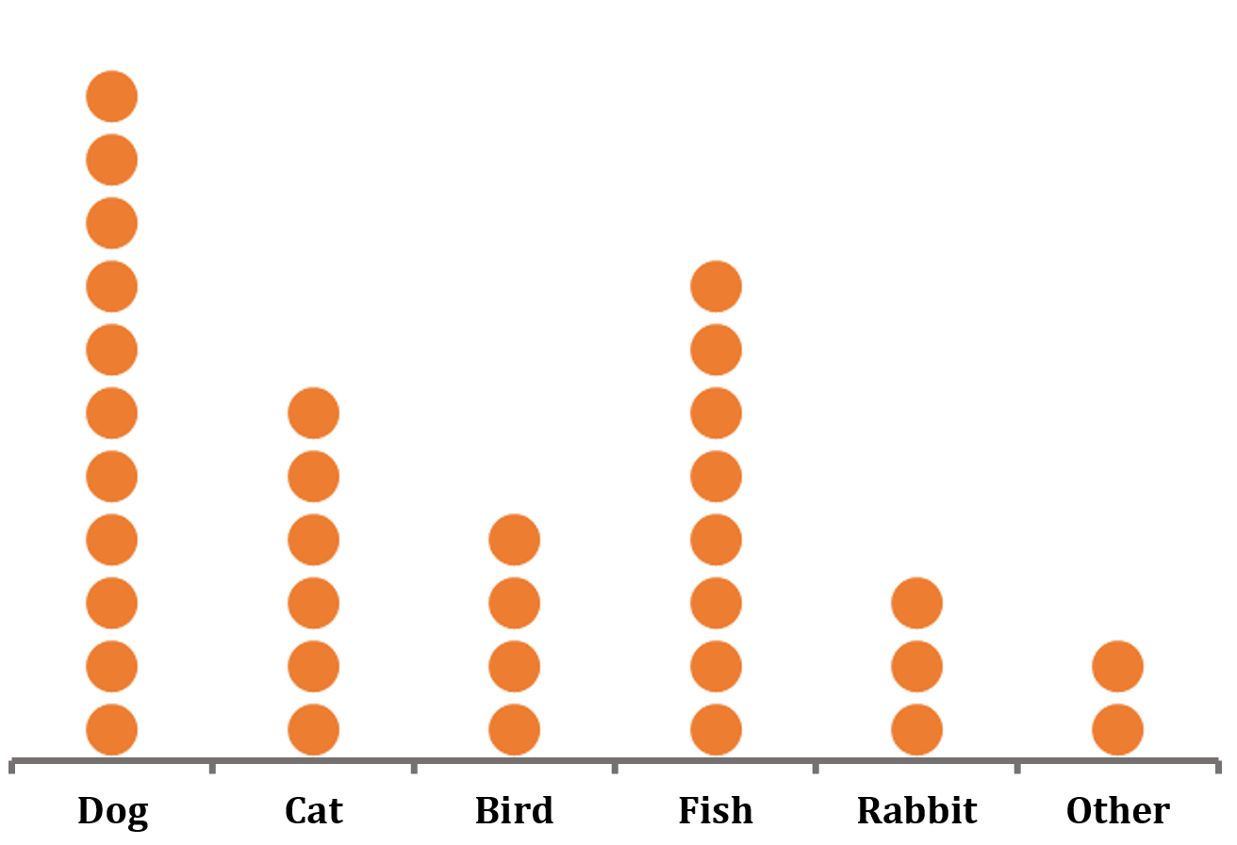
FREQUENCY TABLES AND DOT PLOTS
Type | Count
Dog | 11
Cat | 6
Bird | 4
Fish | 8
Rabbit | 3
Other | 2
To create the dot plot, the counts in the frequency table are converted into dots.
Dot plots are similar to bar graphs because frequency can be seen easily from the height of the dots.
We can also convert between a list of data, a frequency table, and a dot plot
ENGR. VIOLDAN E. BAYOCOT
[Krista K.] BECOME A PROBABILITY & STATISTICS MASTER
QUANTITATIVE METHODS

Slide 22
FREQUENCY TABLES AND DOT PLOTS
Data can be represented as a list, a frequency table, or a dot plot, and these forms can be converted into one another
For example, 12 students participated in a short spelling quiz where scores ranged from 0 to 15:
14, 12, 15, 10, 14, 13, 15, 9, 12, 14, 11, 13
A frequency table can be created to show how many times each score occurred.
ENGR. VIOLDAN E. BAYOCOT
[Krista K.] BECOME A PROBABILITY & STATISTICS MASTER
QUANTITATIVE METHODS

Slide 23
FREQUENCY TABLES AND DOT PLOTS
Data can be represented as a list, a frequency table, or a dot plot, and these forms can be converted into one another
Quiz Score | Count
15 | 2
14 | 3
13 | 2
12 | 2
11 | 1
10 | 1
9 | 1
8 | 0
7 | 0
6 | 0
5 | 0
4 | 0
3 | 0
2 | 0
1 | 0
0 | 0
For example, 12 students participated in a short spelling quiz where scores ranged from 0 to 15:
14, 12, 15, 10, 14, 13, 15, 9, 12, 14, 11, 13
A frequency table can be created to show how many times each score occurred.
ENGR. VIOLDAN E. BAYOCOT
[Krista K.] BECOME A PROBABILITY & STATISTICS MASTER
QUANTITATIVE METHODS

Slide 24
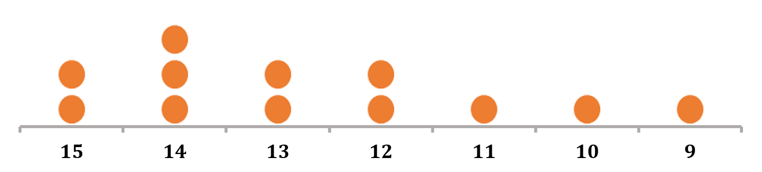
FREQUENCY TABLES AND DOT PLOTS
Quiz Score | Count
15 | 2
14 | 3
13 | 2
12 | 2
11 | 1
10 | 1
9 | 1
8 | 0
7 | 0
6 | 0
5 | 0
4 | 0
3 | 0
2 | 0
1 | 0
0 | 0
Then the data from the frequency table can be turned into a dot plot
ENGR. VIOLDAN E. BAYOCOT
[Krista K.] BECOME A PROBABILITY & STATISTICS MASTER
QUANTITATIVE METHODS

Slide 25
| University of San Jose - Recoletos | School of Computer Studies
| Quantitative Methods | Engr. Violdan E. Bayocot
LESSON 02.04 – RELATIVE FREQUENCY TABLES
MODULE 02
VISUALIZING DATA (PART 2)
ENGR. VIOLDAN E. BAYOCOT
[Krista K.] BECOME A PROBABILITY & STATISTICS MASTER
QUANTITATIVE METHODS

Slide 26
RELATIVE FREQUENCY TABLES
 | Paperback | Hardcover
Fiction | 0.75 | 0.75
Nonfiction | 0.25 | 0.25
18
12
6
4
Of all the paperback books,
What percentage are fiction?
What percentage are nonfcition?
To show percentages, convert the two-way table into a relative frequency table
ENGR. VIOLDAN E. BAYOCOT
[Krista K.] BECOME A PROBABILITY & STATISTICS MASTER
QUANTITATIVE METHODS

Slide 27
RELATIVE FREQUENCY TABLES
 | Paperback | Hardcover
Fiction | 0.75 | 0.75
Nonfiction | 0.25 | 0.25
18
12
6
4
Column Total | 1.0 | 1.00
To show percentages, convert the two-way table into a relative frequency table
Paperback books
Hardcover books
Total = 18 + 6 = 24
Total = 12 + 4 = 16
Fiction: 18/24 = 75%
Fiction: 12/16 = 75%
Nonfiction: 6/24 = 25%
Nonfiction: 4/16 = 25%
ENGR. VIOLDAN E. BAYOCOT
[Krista K.] BECOME A PROBABILITY & STATISTICS MASTER
QUANTITATIVE METHODS

Slide 28
RELATIVE FREQUENCY TABLES
We can also create a relative frequency table from a one-way table.
Club | Count
Drama | 0.30
Science | 0.23
Music | 0.13
Sports | 0.35
Column Total | 1.00
12
9
5
14
40
ENGR. VIOLDAN E. BAYOCOT
[Krista K.] BECOME A PROBABILITY & STATISTICS MASTER
QUANTITATIVE METHODS

Slide 29
COLUMN-RELATIVE FREQUENCY
Club | Count
Drama | 0.30
Science | 0.23
Music | 0.13
Sports | 0.35
Column Total | 1.00
 | Paperback | Hardcover
Fiction | 0.75 | 0.75
Nonfiction | 0.25 | 0.25
Column Total | 1.0 | 1.00
If we convert columns to percentages:
Each column totals 1.00 (100%)
Rows do not necessarily total 1.00
This is called a column-relative frequency table.
ENGR. VIOLDAN E. BAYOCOT
[Krista K.] BECOME A PROBABILITY & STATISTICS MASTER
QUANTITATIVE METHODS

Slide 30
ROW-RELATIVE FREQUENCY
 | Paperback | Hardcover
Fiction | 0.60 | 0.60
Nonfiction | 0.40 | 0.40
18
12
6
4
Instead of columns, we can convert rows to percentages.
Fiction books
Nonfiction books
Total = 18 + 12 = 30
Total = 6 + 4 = 10
Paperback: 18/30 = 60%
Paperback: 6/10 = 60%
Hardcover: 12/30 = 40%
Hardcover: 4/10 = 40%
ENGR. VIOLDAN E. BAYOCOT
[Krista K.] BECOME A PROBABILITY & STATISTICS MASTER
QUANTITATIVE METHODS

Slide 31
ROW-RELATIVE FREQUENCY
 | Paperback | Hardcover
Fiction | 0.60 | 0.60
Nonfiction | 0.40 | 0.40
Row Total
1.00
1.00
Instead of columns, we can convert rows to percentages.
Fiction books
Nonfiction books
Total = 18 + 12 = 30
Total = 6 + 4 = 10
Paperback: 18/30 = 60%
Paperback: 6/10 = 60%
Hardcover: 12/30 = 40%
Hardcover: 4/10 = 40%
ENGR. VIOLDAN E. BAYOCOT
[Krista K.] BECOME A PROBABILITY & STATISTICS MASTER
QUANTITATIVE METHODS

Slide 32
TOTAL RELATIVE FREQUENCY
We can find total-relative frequency by dividing every value by the grand total (40).
 | Paperback | Hardcover | Total
Fiction | 18 | 12 | 30
Nonfiction | 6 | 4 | 10
Total | 24 | 16 | 40
Divide Everything by 40
As Percentages
 | Paperback | Hardcover | Total
Fiction | 0.45 | 0.30 | 0.75
Nonfiction | 0.15 | 0.10 | 0.25
Total | 0.60 | 0.40 | 1.00
 | Paperback | Hardcover | Total
Fiction | 45% | 30% | 75%
Nonfiction | 15% | 10% | 25%
Total | 60% | 40% | 100%
ENGR. VIOLDAN E. BAYOCOT
[Krista K.] BECOME A PROBABILITY & STATISTICS MASTER
QUANTITATIVE METHODS

Slide 33
| University of San Jose - Recoletos | School of Computer Studies
| Quantitative Methods | Engr. Violdan E. Bayocot
LESSON 02.05 – JOINT DISTRIBUTIONS
MODULE 02
VISUALIZING DATA (PART 2)
ENGR. VIOLDAN E. BAYOCOT
[Krista K.] BECOME A PROBABILITY & STATISTICS MASTER
QUANTITATIVE METHODS

Slide 34
JOINT DISTRIBUTIONS
A joint distribution shows the percentage breakdown of two variables together.
 |  | Quiz Points
 |  | 0-10 | 10-20 | 20-30 | 30+ | Total
Hours Studying | 0-3 | 3% | 2% | 1% | 1% | 7%
 | 3-6 | 7% | 5% | 4% | 1% | 17%
 | 6-9 | 2% | 14% | 9% | 5% | 30%
 | 9-12 | 4% | 4% | 11% | 8% | 27%
 | 12+ | 4% | 5% | 5% | 5% | 19%
 | Total | 20% | 30% | 30% | 20% | 100%
Each cell shows the % of people in both categories.
Example interpretation:
3% studied 0-3 hours and scored 0-10 points
11% studied 9-12 hours and scores 20-30 points
ENGR. VIOLDAN E. BAYOCOT
[Krista K.] BECOME A PROBABILITY & STATISTICS MASTER
QUANTITATIVE METHODS

Slide 35
MARGINAL DISTRIBUTION
A marginal distribution shows totals for just one variable.
 |  | Quiz Points
 |  | 0-10 | 10-20 | 20-30 | 30+ | Total
Hours Studying | 0-3 | 3% | 2% | 1% | 1% | 7%
 | 3-6 | 7% | 5% | 4% | 1% | 17%
 | 6-9 | 2% | 14% | 9% | 5% | 30%
 | 9-12 | 4% | 4% | 11% | 8% | 27%
 | 12+ | 4% | 5% | 5% | 5% | 19%
 | Total | 20% | 30% | 30% | 20% | 100%
It comes from:
The bottom row (column totals), or
The right column (row totals)
ENGR. VIOLDAN E. BAYOCOT
[Krista K.] BECOME A PROBABILITY & STATISTICS MASTER
QUANTITATIVE METHODS

Slide 36
CONDITIONAL DISTRIBUTION
A conditional distribution shows the distribution of one variable given a specific value of the other variable.
 |  | Quiz Points
 |  | 0-10 | 10-20 | 20-30 | 30+ | Total
Hours Studying | 0-3 | 42.86% | 28.56% | 14.29% | 14.29% | 100%
 | 3-6 | 41.18% | 29.41% | 23.53% | 5.88% | 100%
 | 6-9 | 6.67% | 46.67% | 30% | 16.66% | 100%
 | 9-12 | 14.81% | 14.81% | 40.75% | 29.63% | 100%
 | 12+ | 21.04% | 26.32% | 26.32% | 26.32% | 100%
 | Total
Given 0–3 hours studying:
Given 30+ pts:
42.86% scored 0–10 pts
28.56% scored 10–20 pts
14.29% scored 20–30 pts
14.29% scored 30+ pts
14.29% studied 0–3 hrs
5.88% studied 3–6 hrs
16.66% studied 6–9 hrs
29.63% studied 9-12 hrs
26.32% studied 12+ hrs
ENGR. VIOLDAN E. BAYOCOT
[Krista K.] BECOME A PROBABILITY & STATISTICS MASTER
QUANTITATIVE METHODS

Slide 37
CONDITIONAL DISTRIBUTION
A conditional distribution shows the distribution of one variable given a specific value of the other variable.
 |  | Quiz Points
 |  | 0-10 | 10-20 | 20-30 | 30+ | Total
Hours Studying | 0-3 | 15% | 6.66% | 3.33% | 5%
 | 3-6 | 35% | 16.67% | 13.33% | 5%
 | 6-9 | 10% | 46.67% | 30% | 25%
 | 9-12 | 20% | 13.33% | 36.67% | 40%
 | 12+ | 20% | 16.67% | 16.67% | 25%
 | Total | 100% | 100% | 100% | 100%
Given 9–12 hours studying:
Given 0-10 pts:
20% scored 0–10 pts
16.67% scored 10–20 pts
16.67% scored 20–30 pts
25% scored 30+ pts
15% studied 0–3 hrs
35% studied 3–6 hrs
10% studied 6–9 hrs
20% studied 9-12 hrs
20% studied 12+ hrs
ENGR. VIOLDAN E. BAYOCOT
[Krista K.] BECOME A PROBABILITY & STATISTICS MASTER
QUANTITATIVE METHODS

Slide 38
| University of San Jose - Recoletos | School of Computer Studies
| Quantitative Methods | Engr. Violdan E. Bayocot
LESSON 02.06 – HISTOGRAMS AND STEM PLOTS
MODULE 02
VISUALIZING DATA (PART 2)
ENGR. VIOLDAN E. BAYOCOT
[Krista K.] BECOME A PROBABILITY & STATISTICS MASTER
QUANTITATIVE METHODS

Slide 39
HISTOGRAM
A histogram (frequency histogram) is like a bar graph, but:
Data is grouped into equal-width bins
Bars touch (no gaps)
Used for continuous quantitative data
Why Use a Histogram?
When there are too many data points to show individually.
Maybe we want to use city records to make a graph of the number of vehicles of each age in the entire city of Manila
Instead of 30+ bars (year-old 0, 1, 2, … 30), group into:
0–4
4–7
7–11
etc.
ENGR. VIOLDAN E. BAYOCOT
[Krista K.] BECOME A PROBABILITY & STATISTICS MASTER
QUANTITATIVE METHODS

Slide 40
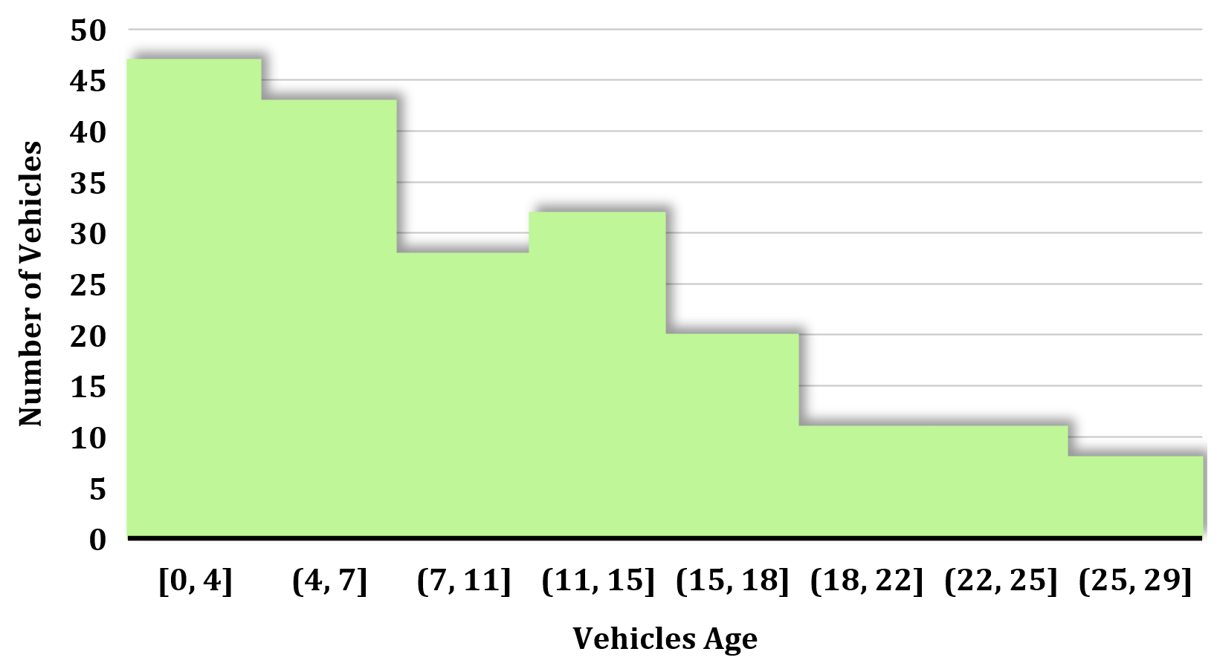
HISTOGRAM
The shape of the graph shows the distribution of the data
Maybe we want to use city records to make a graph of the number of vehicles of each age in the entire city of Manila
Instead of 30+ bars (year-old 0, 1, 2, … 30), group into:
0–4
4–7
7–11
etc.
Qualitative data → Bar graph
Quantitative data → Histogram
ENGR. VIOLDAN E. BAYOCOT
[Krista K.] BECOME A PROBABILITY & STATISTICS MASTER
QUANTITATIVE METHODS

Slide 41
STEM-AND-LEAF PLOT
A stem-and-leaf plot groups numbers by leading digit(s).
Example Data:
72, 73,74, 75, 75, 76, 76, 77, 78, 78, 78, 79, 80, 81, 82, 83, 85, 88
7 | 2, 3, 4, 5, 5, 6, 6, 7, 8, 8, 8, 9
8 | 0, 1, 2, 3, 5, 8
Key: 7|2 = 72
Leaf = always one digit
Stem = all remaining digits
ENGR. VIOLDAN E. BAYOCOT
[Krista K.] BECOME A PROBABILITY & STATISTICS MASTER
QUANTITATIVE METHODS

Slide 42
STEM-AND-LEAF PLOT
A stem-and-leaf plot groups numbers by leading digit(s).
Example Data:
72, 73,74, 75, 75, 76, 76, 77, 78, 78, 78, 79, 80, 81, 82, 83, 85, 88
7 | 2, 3, 4, 5, 5, 6, 6, 7, 8, 8, 8, 9
8 | 0, 1, 2, 3, 5, 8
Why Use Stem Plots?
Show exact values
Show distribution shape
Good for small to medium datasets
Key: 7|2 = 72
Leaf = always one digit
Stem = all remaining digits
ENGR. VIOLDAN E. BAYOCOT
[Krista K.] BECOME A PROBABILITY & STATISTICS MASTER
QUANTITATIVE METHODS

Slide 43
NO DIGIT, OR MORE THAN ONE DIGIT IN STEM
Leaf = always one digit
Stem = all remaining digits
Adding Single-Digit Numbers (6, 8, 9)
Option 1: Leave stem blank
 | 6, 8, 9
7 | 2, 3, 4, 5, 5, 6, 6, 7, 8, 8, 8, 9
8 | 0, 1, 2, 3, 5, 8
Adding 104
7 | 2, 3, 4, 5, 5, 6, 6, 7, 8, 8, 8, 9
8 | 0, 1, 2, 3, 5, 8
10 | 4
Option 2: Use 0 as the stem
0 | 6, 8, 9
7 | 2, 3, 4, 5, 5, 6, 6, 7, 8, 8, 8, 9
8 | 0, 1, 2, 3, 5, 8
ENGR. VIOLDAN E. BAYOCOT
[Krista K.] BECOME A PROBABILITY & STATISTICS MASTER
QUANTITATIVE METHODS

Slide 44
| University of San Jose - Recoletos | School of Computer Studies
| Quantitative Methods | Engr. Violdan E. Bayocot
LESSON 02.07 – BUILDING HISTOGRAMS FROM DATASETS
MODULE 02
VISUALIZING DATA (PART 2)
ENGR. VIOLDAN E. BAYOCOT
[Krista K.] BECOME A PROBABILITY & STATISTICS MASTER
QUANTITATIVE METHODS

Slide 45
BUILDING HISTOGRAM FROM DATASETS
Class (Bin / Class Interval)
Groups of equal width
Example: 5–9, 10–14
Class width = 14 − 9 = 5 (or 10 − 5 = 5)
Class Width
Difference between consecutive upper or lower limits
Class Midpoint
Middle of a class
Formula: (Lower + Upper) ÷ 2
Example: 100–104 → Midpoint = 102
Odd widths (like 5) give whole-number midpoints
ENGR. VIOLDAN E. BAYOCOT
[Krista K.] BECOME A PROBABILITY & STATISTICS MASTER
QUANTITATIVE METHODS

Slide 46
STEPS TO BUILD A HISTOGRAM
Arrange data in ascending order
Find the range (max − min)
Choose number of classes (usually 5–6)
Class width = Range ÷ # of classes → round up
Create class intervals
Count frequencies
Draw histogram (bars touch)
! If intervals are 0–4 and 4–8 → … 4 goes in the second class.
ENGR. VIOLDAN E. BAYOCOT
[Krista K.] BECOME A PROBABILITY & STATISTICS MASTER
QUANTITATIVE METHODS

Slide 47

STEPS TO BUILD A HISTOGRAM
Data (20 employees – minutes spent exercising)
12, 25, 18, 30, 22, 15, 27, 10, 20, 17, 16, 24, 28, 35, 14, 19, 23, 32, 21, 26
Step 1: Sort Data
10, 12, 14, 15, 16, 17, 18, 19, 20, 21, 22, 23, 24, 25, 26, 27, 28, 30, 32, 35
Step 2: Range
35 − 10 = 25
Step 3: Class Width
$$\frac{25}{5} = 5$$
ENGR. VIOLDAN E. BAYOCOT
[Krista K.] BECOME A PROBABILITY & STATISTICS MASTER
QUANTITATIVE METHODS

Slide 48
FREQUENCY TABLE
Data (20 employees – minutes spent exercising)
10, 12, 14, 15, 16, 17, 18, 19, 20, 21, 22, 23, 24, 25, 26, 27, 28, 30, 32, 35
Classes | Frequency
10 – 15 | 4
15 – 20 | 5
20 – 25 | 5
25 – 30 | 4
30 – 35 | 2
ENGR. VIOLDAN E. BAYOCOT
[Krista K.] BECOME A PROBABILITY & STATISTICS MASTER
QUANTITATIVE METHODS

Slide 49
FREQUENCY TABLE
Data (20 employees – minutes spent exercising)
10, 12, 14, 15, 16, 17, 18, 19, 20, 21, 22, 23, 24, 25, 26, 27, 28, 30, 32, 35
Classes | Frequency
10 – 15 | 4
15 – 20 | 5
20 – 25 | 5
25 – 30 | 4
30 – 35 | 2
Class Midpoint
12.5
17.5
22.5
27.5
32.5
ENGR. VIOLDAN E. BAYOCOT
[Krista K.] BECOME A PROBABILITY & STATISTICS MASTER
QUANTITATIVE METHODS

Slide 50
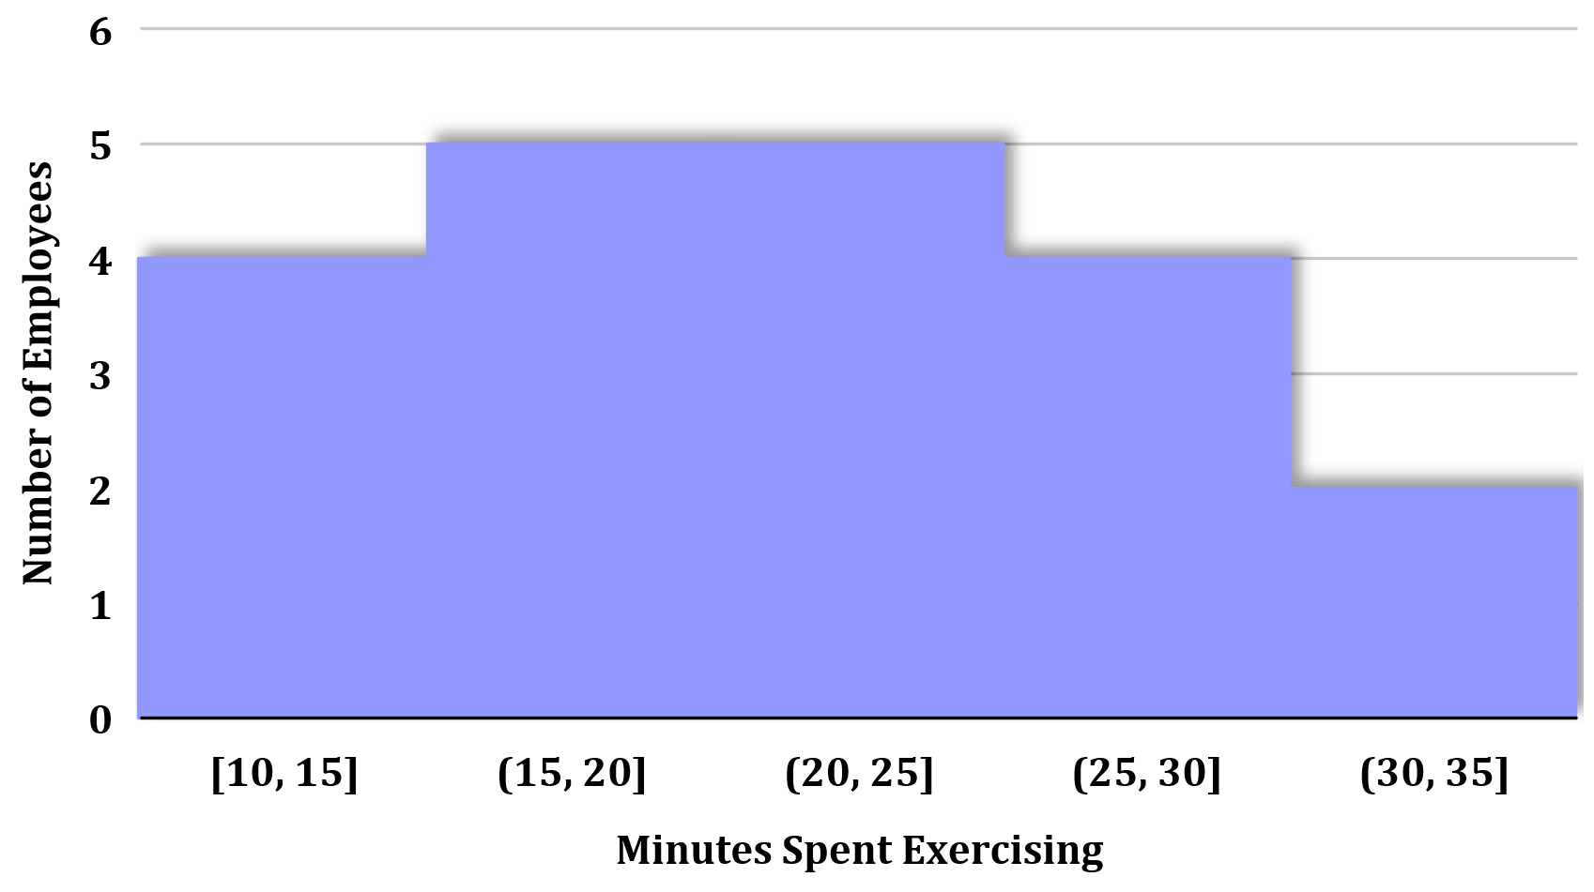
CREATING THE HISTOGRAM
Data (20 employees – minutes spent exercising)
10, 12, 14, 15, 16, 17, 18, 19, 20, 21, 22, 23, 24, 25, 26, 27, 28, 30, 32, 35
ENGR. VIOLDAN E. BAYOCOT
[Krista K.] BECOME A PROBABILITY & STATISTICS MASTER
QUANTITATIVE METHODS

Slide 51
UNIVERSITY OF SAN JOSE - RECOLETOS
THANK YOU!
“The greatest value of a picture is when it forces us to notice what we never expected to see.”
— John W. Tukey
ENGR. VIOLDAN E. BAYOCOT
SCHOOL OF COMPUTER STUDIES

